Slide 1
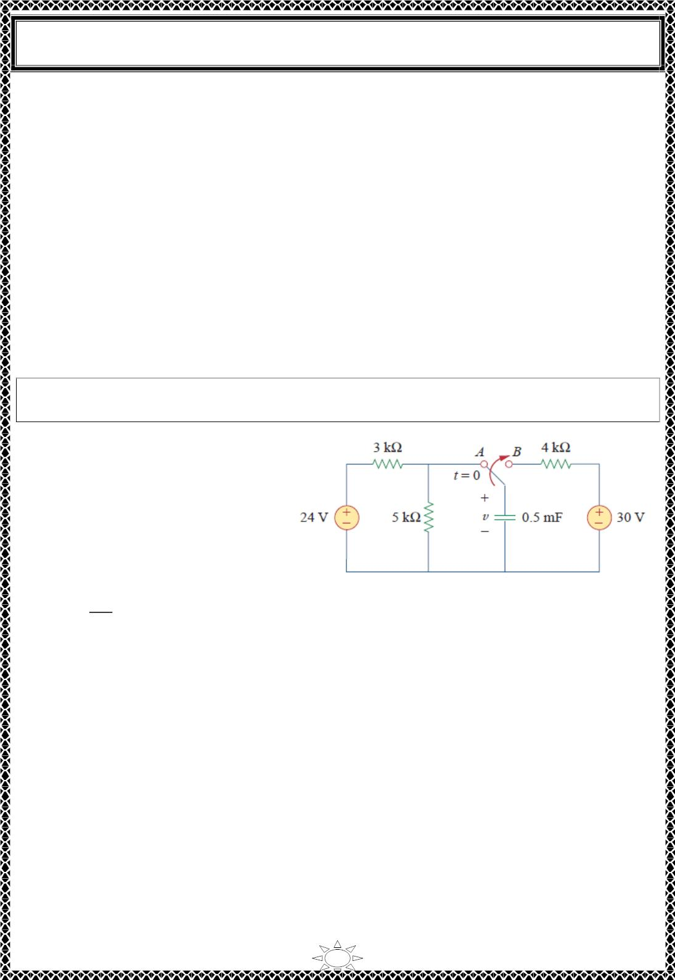
University of Diyala
Engineering College
Electrical Circuits
2. The final capacitor voltage 푣(∞) .
3. The time constant 휏.
We obtain item 1 from the given circuit for 푡 < 0 and items 2 and 3 from the circuit for
푡 > 0. Once these items are determined, we obtain the response using Eq. (5.13). This
technique equally applies to 푅퐿 circuits, as we shall see in the next section.
Note that if the switch changes position at time 푡 = 푡ꢀ instead of at 푡 = 0, there is a time
delay in the response so that Eq. (5.13) becomes
푣(푡) = 푣(∞) + [푣(푡 ) − 푣(∞)]푒^{ꢁ(ꢂꢁꢂ )/ꢃ}
(5.14)
ꢀ
푂
ꢄ
where 푣(푡 ) is the initial value at 푡 = 푡 . Keep in mind that Eq. (5.13) or (5.14) applies
ꢀ
ꢀ
only to step responses, that is, when the input excitation is constant.
Example 10: The switch in Fig.1 has been in position 퐴 for along time. At 푡 = 0, the
switch moves to 퐵. Determine 푣(푡) for 푡 > 0 and calculate its value at 푡 = 1푠 and 4 푠.
Solution: For 푡 < 0, the switch is at
position 퐴. The capacitor acts like an
open circuit to 푑푐, but 푣 is the same
as the voltage across the 5 − 푘훺
resistor. Hence, the voltage across
the capacitor just before 푡 = 0 is
obtained by voltage division as
Trail Version
Trail Version
Trail Version
Trail Version
Trail Version
Trail Version
Trail Version
Trail Version
Trail Version
Trail Version
Trail Version
Trail Version
Trail Version
ꢅ
푣(0ꢁ) =
(24) = 15푉
Fig.1
ꢅꢄ3
Using the fact that the capacitor voltage cannot change instantaneously,
푣(ꢆ) = 푣(0ꢁ) = 푣(0^{ꢄ}) = 15푉
For 푡 > 0, the switch is in position 퐵. The Thevenin resistance connected to the capacitor
is 푅_{푇ℎ} = 4푘훺, and the time constant is
휏 = 푅_{푇ℎ}퐶 = 4 × 10³ × 0.5 × 10^{ꢁ3} = 2푠
Since the capacitor acts like an open circuit to dc at steady state, 푣(∞) = ꢇ0 V. Thus,
푣(푡) = 푣(∞) + [푣(0) − 푣(∞)]푒^{ꢁꢂ/ꢃ} = ꢇ0 + (15 − ꢇ0)푒^{ꢁꢂ/ꢈ} = (ꢇ0 − 15푒^{ꢁꢀ.ꢅꢂ})푉
At 푡 = 1, ⇒ 푣(1) = ꢇ0 − 15푒^{ꢁꢀ.ꢅ = 20.9푉}
At 푡 = 4, ⇒ 푣(4) = ꢇ0 − 15푒^{ꢁꢈ = 27.97푉}
28

Slide 2
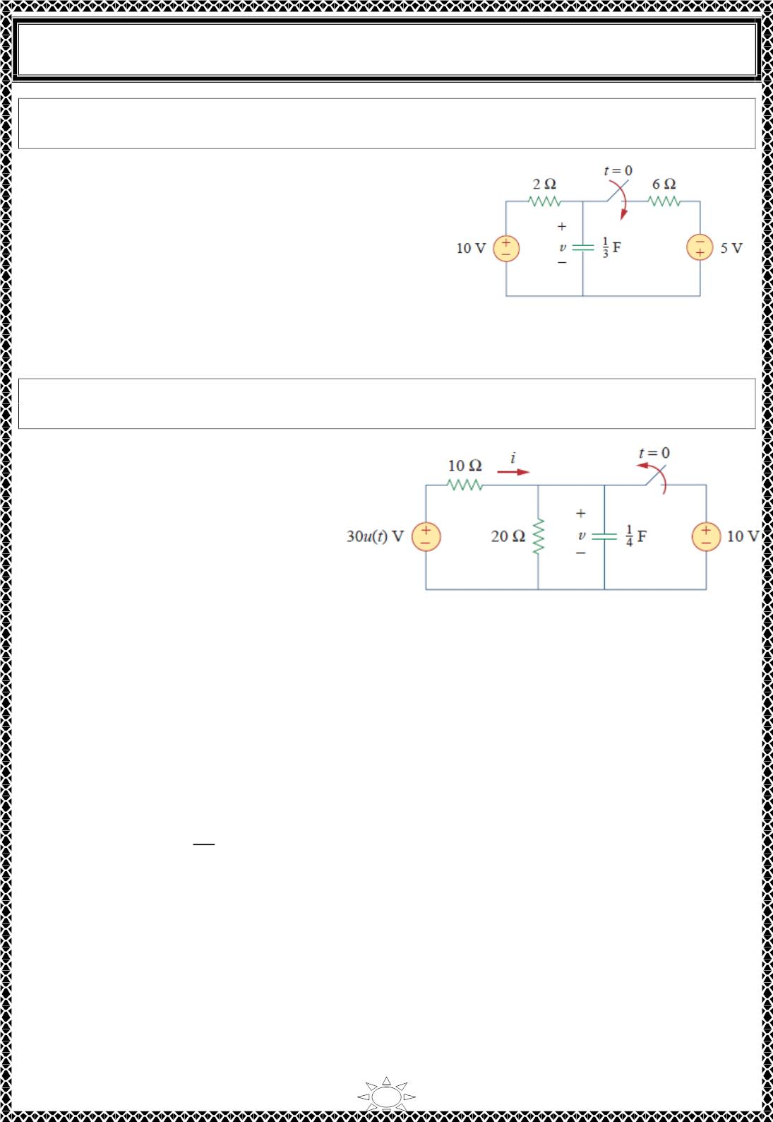
University of Diyala
Engineering College
Electrical Circuits
H.W. 10: Find 푣(푡) for 푡 > 0 in the circuit of Fig.1. Assume the switch has been open for
a long time and is closed at 푡 = 0. Calculate 푣(푡) at 푡 = 0.5
Answer: (ퟔ. ퟐퟓ + ퟑ. ퟕퟓ풆^{−ퟐ풕)푽} for all
풕 >
ퟎ, ퟕ. ퟔퟑ푽.
Example 11: In Fig.1, the switch has been closed for a long time and is opened at 푡 = 0.
Find ꢀ and 푣 for all time.
Solution: The resistor current ꢀ can
be discontinuous at 푡 = 0, while the
capacitor voltage 푣 cannot. Hence, it
is always better to find 푣 and then
obtain ꢀ from 푣.
Trail Version
Trail Version
Trail Version
Trail Version
Trail Version
Trail Version
Trail Version
Trail Version
Trail Version
Trail Version
Trail Version
Trail Version
Trail Version
By definition of the unit step function,
0,
30푢(푡) = {
30, 푡 > 0
푡 < 0
Fig.1
For 푡 < 0, the switch is closed and 30푢(푡) = 0, so that the 30푢(푡) voltage source is
replaced by a short circuit and should be regarded as contributing nothing to 푣. Since the
switch has been closed for a long time, the capacitor voltage has reached steady state and
the capacitor acts like an open circuit. Hence, the circuit becomes that shown in Fig.2 (a)
for 푡 < 0. From this circuit we obtain
푣 = 10푉,
푣
ꢀ = ꢁ
= ꢁ1퐴
10
Since the capacitor voltage cannot change instantaneously,
푣(푂) = 푣(0−) = 10푉
For 푡 > 0, the switch is opened and the 10‐푉 voltage source is disconnected from the
circuit. The 30푢(푡) voltage source is now operative, so the circuit becomes that shown in
Fig.2 (b). After a long time, the circuit reaches steady state and the capacitor acts like an
open circuit (b) again. We obtain 푣(∞) by using voltage division, writing
29

Slide 3
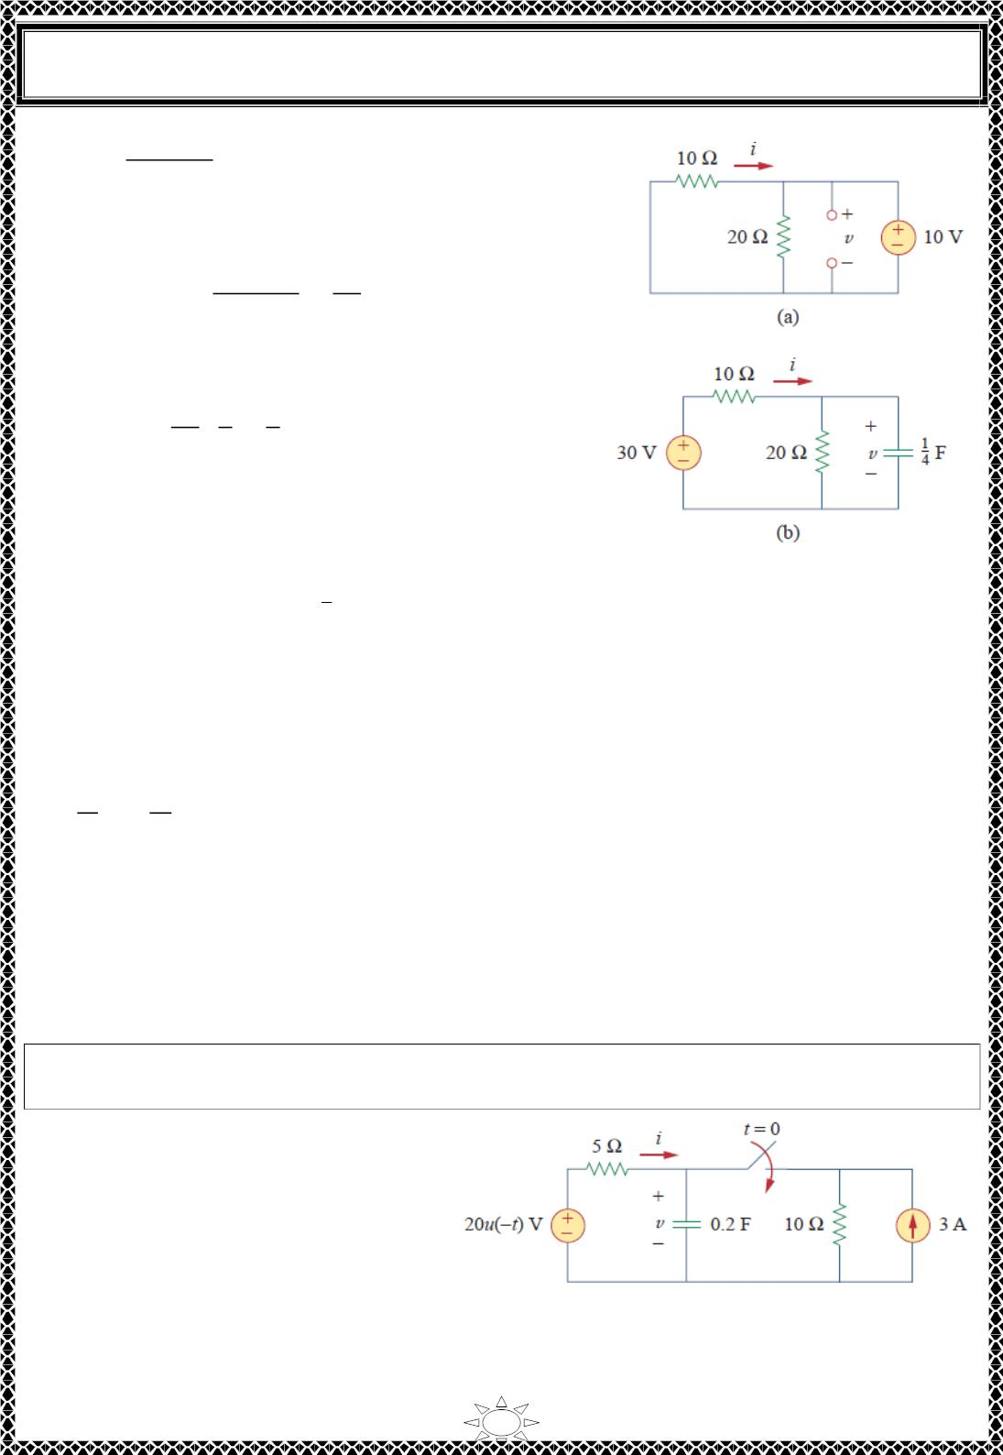
University of Diyala
Engineering College
Electrical Circuits
20
푣(∞) =
(30) = 20푉
20 + 10
The Thevenin resistance at the capacitor terminals is
푅_{푇ℎ} = 10‖20 =
10 × 20 20
30
and the time constant is
=
훺
3
20 1
⋅ = 푠
3 4
휏 = 푅_{푇ℎ}퐶 =
5
3
Thus,
푣(푡) = 푣(∞) + [푣(푂) − 푣(∞)]푒^{ꢀꢁ/ꢂ}
ꢄ
Fig.2 (a) for t<0, for t>0.
= 20 + (10 − 20)푒
ꢀꢃ ꢆꢁ
ꢅ
= (20 − 10푒^{ꢀꢇ.6ꢁ})푉
Trail Version
Trail Version
Trail Version
Trail Version
Trail Version
Trail Version
Trail Version
Trail Version
Trail Version
Trail Version
Trail Version
Trail Version
Trail Version
To obtain ꢈ, we notice from Fig.2 (b) that ꢈ is the sum of the currents through the 20 − 훺
resistor and the capacitor; that is,
ꢉ
푑ꢉ
ꢈ = + 퐶 = 1 − 0.5푒^{ꢀꢇ.6ꢁ} + 0.25(−0.ꢋ)(−10)푒^{ꢀꢇ.6ꢁ} = (1 + 푒^{ꢀꢇ.6ꢁ})퐴
ꢊꢇ
푑ꢁ
Notice from Fig.2 (b) that 푣 + 10ꢈ = 30 is satisfied, as expected. Hence,
10푉, 푡 < 0 ‐ 1퐴, 푡 < 0
푣 = { ꢈ = {
(20 − 10푒^{ꢀꢇ.6ꢁ})푉, 푡 ≥ 0 (1 + 푒^{ꢀꢇ.6ꢁ})퐴, 푡 > 0
Notice that the capacitor voltage is continuous while the resistor current is not.
H.W. 11: The switch in Fig.1 is closed at 푡 = 0. Find ꢈ(푡) and 푢(푡) for all time. Note that
푢(−푡) = 1 for 푡 < 0 and 0 for 푡 > 0. Also, 푢(−푡) = 1 − 푢(푡) .
Answer:
ퟎ,
풕 < ퟎ
풊(풕) = {
−ퟐ(ퟏ + 풆^{ꢀퟏퟓ풕})푨, 풕 > ퟎ’
풗 = {
ퟐퟎ푽,
풕 < ퟎ
ퟏퟎ(ퟏ + 풆^{ꢀퟏퟓ풕})푽, 풕 > ퟎ
Fig.1
30

Slide 4

University of Diyala
Engineering College
Electrical Circuits
6) Step Response of an 푹푳 Circuit
Consider the 푅퐿 circuit in Fig.6.1 (a), which may be replaced by the circuit in Fig.6.1 (b).
Rather than apply Kirchhoff’s laws, we will use the simple technique in Eqs. (5.11)
through (5.14). Let the response be the sum of the transient response and the steady‐state
response,
ꢀ = ꢀ_{푡} + ꢀ_{푠푠}
(6.1)
We know that the transient response is always a decaying exponential, that is,
ꢀ_{푡} = 퐴푒^{−푡/휏},
ꢂ
ꢁ =
(6.2)
ꢃ
where 퐴 is a constant to be determined.
The steady‐state response is the value of the current a long time after the switch in Fig.6.1
(a) is closed. We know that the transient response essentially dies out after five time
constants. At that time, the inductor becomes a short circuit, and the voltage across it is
zero. The entire source voltage 푉_{푠} appears across 푅. Thus, the steady‐state response is
Trail Version
Trail Version
Trail Version
Trail Version
Trail Version
Trail Version
Trail Version
Trail Version
Trail Version
Trail Version
Trail Version
Trail Version
Trail Version
ꢄ
ꢅ
ꢀ =
푠푠
(6.3)
ꢃ
Substituting Eqs. (6.2) and (6.3) into Eq. (6.1) gives
ꢄ
ꢀ = 퐴푒^{−푡/휏} +
ꢅ
(6.4)
ꢃ
We now determine the constant 퐴 ffom the initial value of ꢀ. Let 퐼₀ be the initial current
through the inductor, which may come from a source other than 푉_{푠}. Since the current
through the inductor cannot change instantaneously,
ꢀ(ꢆ^{ꢇ}) = ꢀ(ꢆ−) = 퐼₀
(6.5)
Thus, at ꢈ = ꢆ, Eq. (6.4) becomes
푉
푠
퐼₀ = 퐴 +
푅
From this, we obtain 퐴 as
푉
푠
퐴 = 퐼₀ ꢉ
푅
Substituting for 퐴 in Eq. (6.4), we get
31

Slide 5
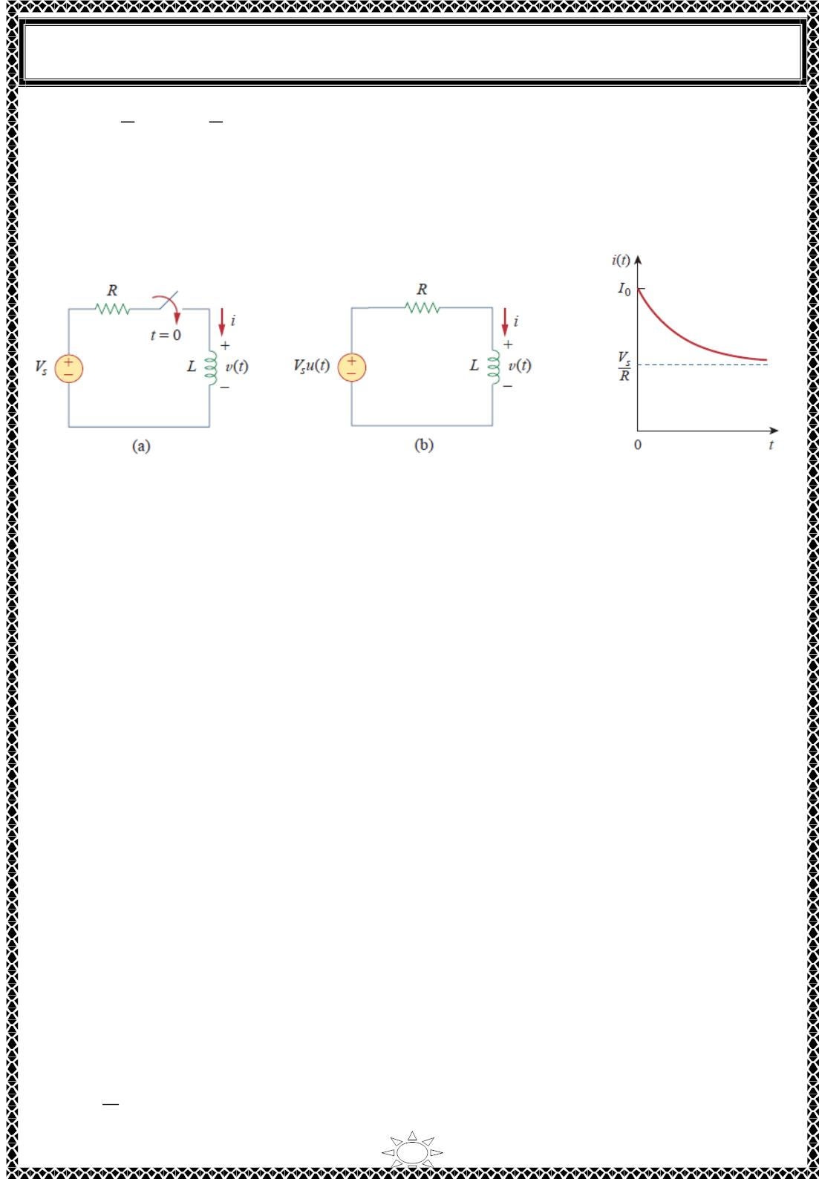
University of Diyala
Engineering College
Electrical Circuits
푉
푉
푠
푅
푠
)푒^{ꢁꢂ/}휏
ꢀ(푡) =
+ (퐼₀ −
(6.6)
푅
This is the complete response of the ꢃ퐿 circuit. It is illustrated in Fig.6.2. The response in
Eq. (6.6) may be written as
ꢀ(푡) = ꢀ(∞) + [ꢀ(푂) − ꢀ(∞)]푒^{ꢁꢂ/ꢄ}
(6.7)
Fig.6.1 An RL circuit with a
step input voltage.
Fig.6.2 Total response of
ꢃ퐿 circuit with initial
the
inductor current 퐼₀.
Trail Version
Trail Version
Trail Version
Trail Version
Trail Version
Trail Version
Trail Version
Trail Version
Trail Version
Trail Version
Trail Version
Trail Version
Trail Version
where ꢀ(푂) and ꢀ(∞) are the initial and final values of ꢀ, respectively. Thus, to find the
step response of an ꢃ퐿 circuit requires three things:
1. The initial inductor current ꢀ(푂) at 푡 = ꢅ.
2. The final inductor current ꢀ(∞) .
3. The time constant 휏.
We obtain item 1 from the given circuit for 푡 < ꢅ and items 2 and 3 from the circuit for
푡 > ꢅ. Once these items are determined, we obtain the response using Eq. (6.7). Keep in
mind that this technique applies only for step responses.
Again, if the switching takes place at time 푡 = 푡₀ instead of 푡 = ꢅ, Eq. (6.7) becomes
ꢀ(푡) = ꢀ(∞) + [ꢀ(푡 ) − ꢀ(∞)]푒^{ꢁ(ꢂꢁꢂ )/ꢄ}
If 퐼₀ = ꢅ, then
(6.8)
0
표
ꢅ,
푡 < ꢅ
ꢆ
ꢀ(푡) = {
(6.9a)
ꢇ
ꢃ
(1 − 푒^{ꢁꢂ/ꢄ}) , 푡 > ꢅ
32

Slide 6
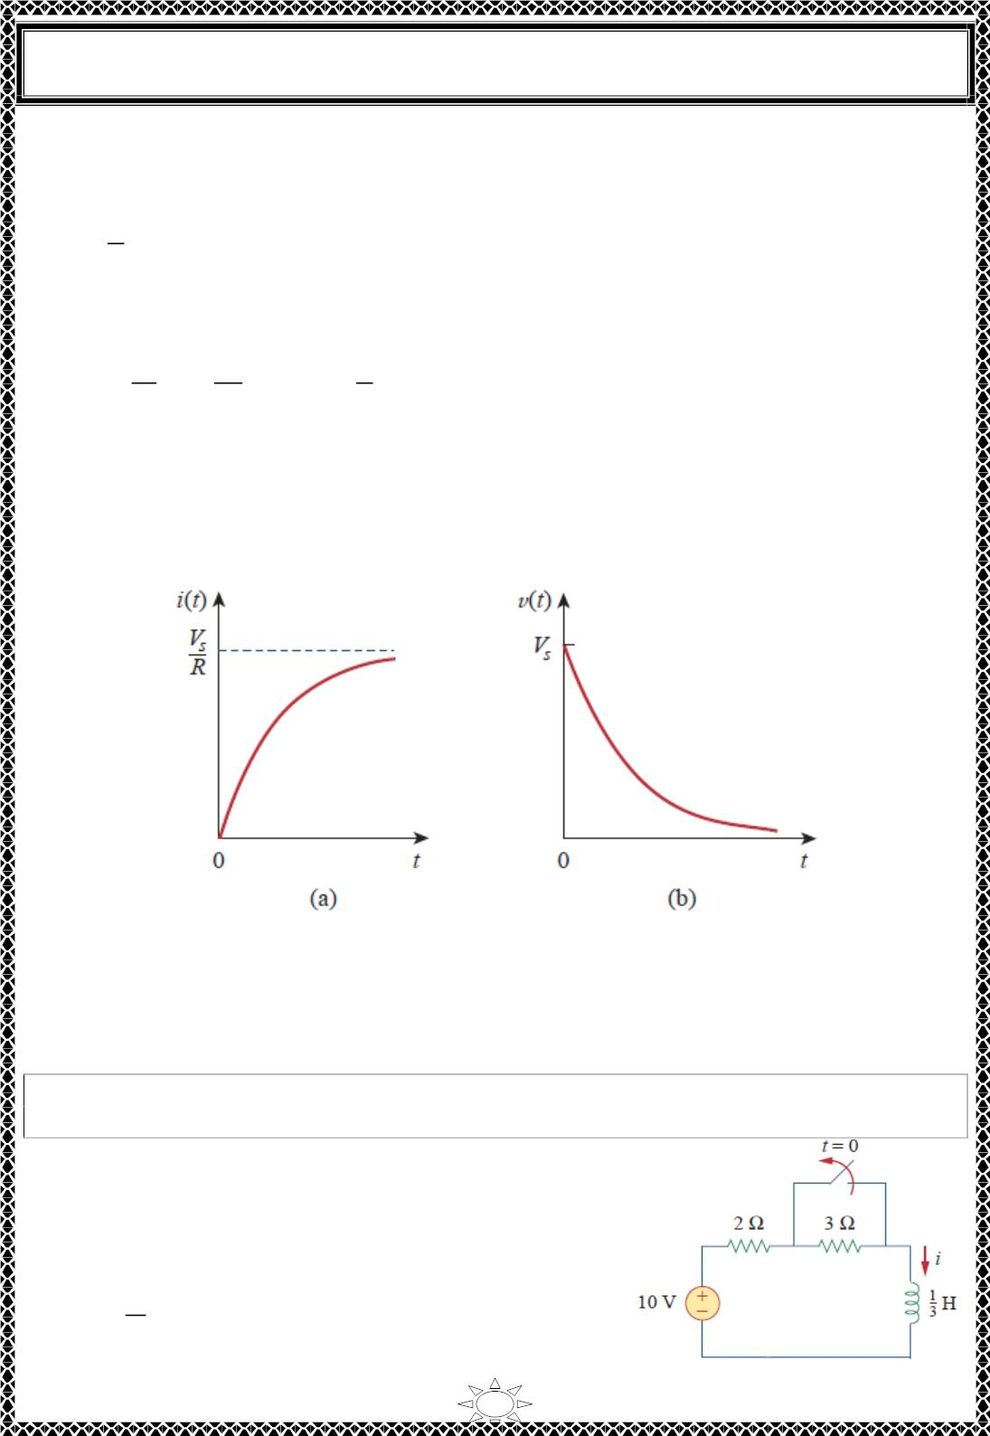
University of Diyala
Engineering College
Electrical Circuits
or
푉
(1 − 푒^{ꢁꢂ/휏})푢(푡)
푠
ꢀ(푡) =
(6.9b)
푅
This is the step response of the ꢃ퐿 circuit with no initial inductor current. The voltage
across the inductor is obtained from Eq. (6.9) using 푣 = 퐿푑ꢀ/푑푡. We get
푑ꢀ
푣(푡) = 퐿 = ꢄ
퐿
퐿
푑푡
ꢅ
푒^{ꢁꢂ/휏}, ꢆ = , 푡 > 0
ꢃ
ꢆꢃ
or
푣(푡) = ꢄ_{ꢅ}푒^{ꢁꢂ/휏}푢(푡)
Fig.6.3 shows the step responses in Eqs. (6.9) and (6.10).
(6.10)
Trail Version
Trail Version
Trail Version
Trail Version
Trail Version
Trail Version
Trail Version
Trail Version
Trail Version
Trail Version
Trail Version
Trail Version
Trail Version
Fig.6.3 Step responses of an ꢃ퐿 circuit with no initial inductor current: (a) current
response, (b) voltage response.
Example 12: Find ꢀ(푡) in the circuit of Fig.1 for 푡 > 0. Assume that the switch has been
closed for a long time.
Solution: When 푡 < 0, the 3 − 훺 resistor is
short‐circuited, and the inductor acts like a short circuit.
The current through the inductor at 푡 = 0^{ꢁ(ꢀ. 푒.}, just
before 푡 = 0) is
ꢇꢈ
ꢀ(0ꢁ) = = 5퐴
Fig.1
2
33

Slide 7
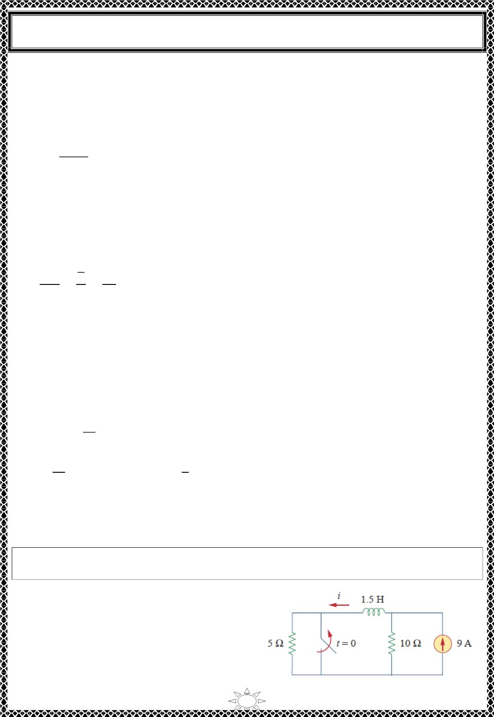
University of Diyala
Engineering College
Electrical Circuits
Since the inductor current cannot change instantaneously,
ꢀ(푂) = ꢀ(0+) = ꢀ(0−) = 5퐴
When 푡 > 0, the switch is open. The 2 ꢁ 훺 and 3 ꢁ 훺 resistors are in series, so that
ꢀ(∞) =
10
= 2퐴
2 ꢂ 3
The Thevenin resistance across the inductor terminals is
푅_{푇ℎ} = 2 ꢂ 3 = 5훺
For the time constant,
1
휏 =
퐿
3
5
1
=
=
푠
푅_{푇ℎ}
15
Thus,
Trail Version
Trail Version
Trail Version
Trail Version
Trail Version
Trail Version
Trail Version
Trail Version
Trail Version
Trail Version
Trail Version
Trail Version
Trail Version
ꢀ(푡) = ꢀ(∞) ꢂ [ꢀ(푂) ꢁ ꢀ(∞)]푒−ꢃ/ꢄ
= 2 ꢂ (5 ꢁ 2)푒^{−ꢅꢆꢃ} = 2 ꢂ 3푒^{−ꢅꢆꢃ}퐴, 푡 > 0
Check.⋅ In Fig.1, for 푡 > 0, KVL must be satisfied; that is,
푑ꢀ
10 = 5ꢀ ꢂ 퐿
푑푡
푑ꢀ
푑푡
1
5ꢀ ꢂ 퐿
= [10 ꢂ 15푒^{−ꢅꢆꢃ}] ꢂ [ (3)(ꢁ15)푒^{−ꢅꢆꢃ}] = 10
3
This confirms the result.
H.W. 12: The switch in Fig.1 has been closed for a long time. It opens at 푡 = 0. Find ꢀ(푡)
for 푡 > 0.
Answer: (ퟔ ꢂ ퟑ풆^{−ퟏퟎ풕)} A for all
풕 > ퟎ.
Fig.1
34

Slide 8
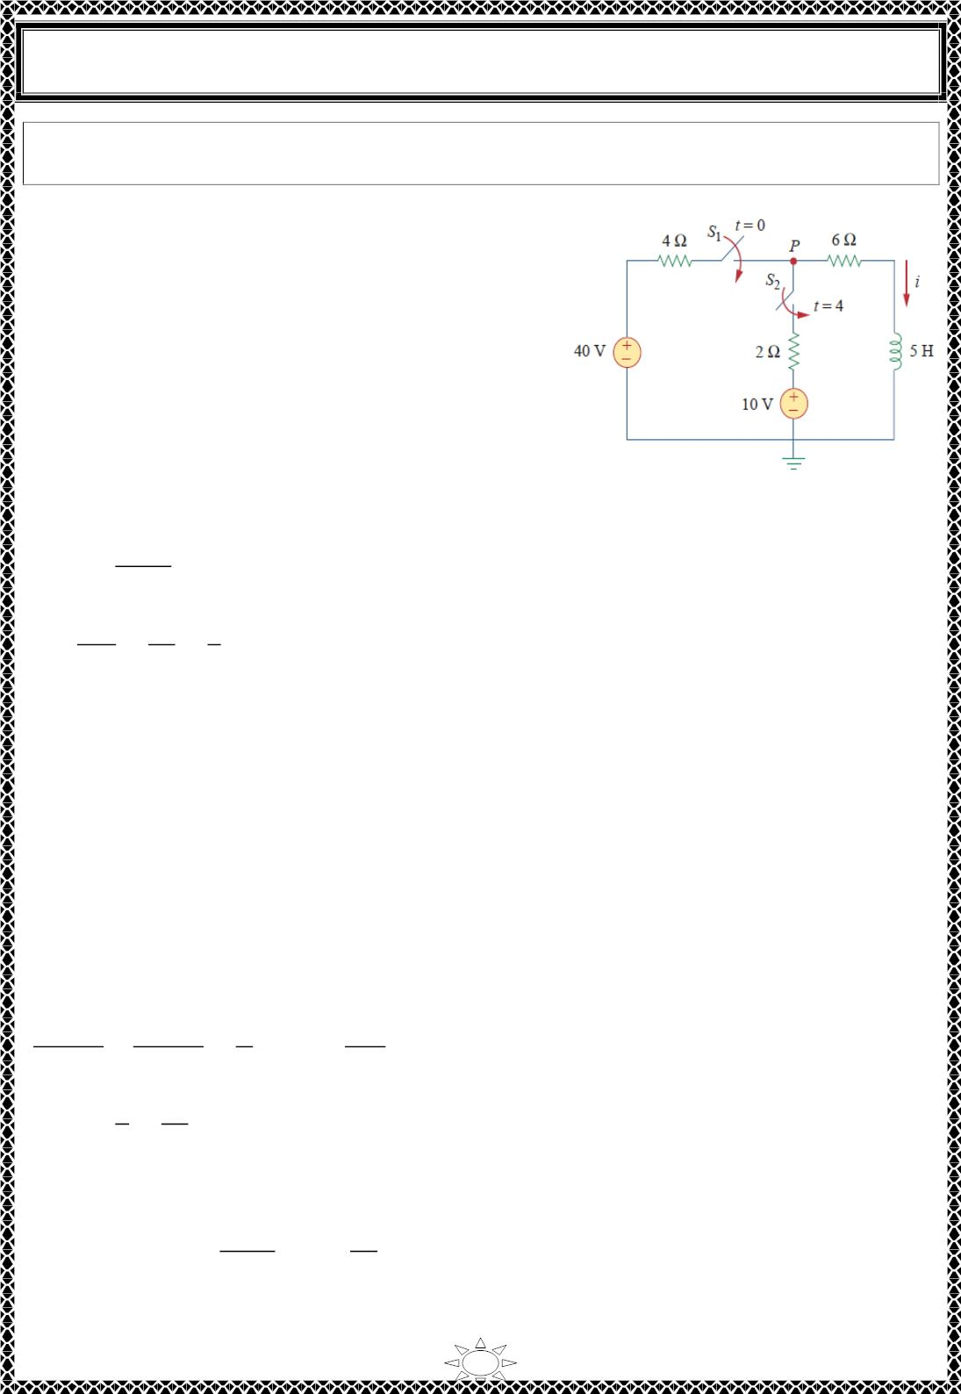
University of Diyala
Engineering College
Electrical Circuits
Example 13: At 푡 = 0, switch 1 in Fig.1is closed, and switch 2 is closed 4 푠 later. Find
ꢀ(푡) for 푡 > 0. Calculate ꢀ for 푡 = 2푠 and 푡 = 5푠.
Solution: We need to consider the three time
intervals 푡 ≤ 0, 0 ≤ 푡 ≤ 4, and 푡 ≥ 4 separately. For
푡 < 0, switches 푆 and 푆 are open so that ꢀ = 0.
1
ꢁ
Since the inductor current cannot change instantly,
ꢀ(0−) = ꢀ(푂) = ꢀ(0+) = 0
For 0 ≤ 푡 ≤ 4, 푆₁ is closed so that the 4 ꢂ 훺 and
6 ꢂ 훺 resistors are in series. (Remember, 푎푡 this
time, 푆ꢁ ꢀ푠 still open.) Hence, assuming for now that
푆₁ is closed forever,
Fig.1
ꢀ(∞) =
40
= 4퐴, 푅_{푇ℎ} = 4 ꢃ 6 = ꢄ0훺
4 ꢃ 6
퐿
5
ꢄ
= 푠
2
Trail Version
Trail Version
Trail Version
Trail Version
Trail Version
Trail Version
Trail Version
Trail Version
Trail Version
Trail Version
Trail Version
Trail Version
휏 =
Trail Version
=
푅_{푇ℎ} ꢄ0
Thus,
ꢀ(푡) = ꢀ(∞) ꢃ [ꢀ(푂) ꢂ ꢀ(∞)]푒^{−ꢅ/ꢆ} = 4 ꢃ (0 ꢂ 4)푒^{−ꢁꢅ} = 4(ꢄ ꢂ 푒^{−ꢁꢅ})퐴, 0 ≤ 푡 ≤ 4
For 푡 ≥ 4, 푆ꢁ is closed; the 10‐푉 voltage source is connected, and the circuit changes. This
sudden change does not affect the inductor current because the current cannot change
abruptly. Thus, the initial current is
ꢀ(4) = ꢀ(4−) = 4(ꢄ ꢂ 푒⁻⁸) = 4퐴
To find ꢀ(∞) , let 푣 be the voltage at node 푃 in Fig.1. Using KCL,
40 ꢂ 푣 ꢄ0 ꢂ 푣
푈
6
ꢄꢇ0
ꢄꢄ
4
ꢃ
2
=
⇒ 푣 =
푉
푣
6
30
ꢄꢄ
ꢀ(∞) =
=
= 2.727퐴
The Thevenin resistance at the inductor terminals is
푅_{푇ℎ} = 4‖2 ꢃ 6 =
4 × 2
6
ꢃ 6 =
22
3
훺
and
35

Slide 9
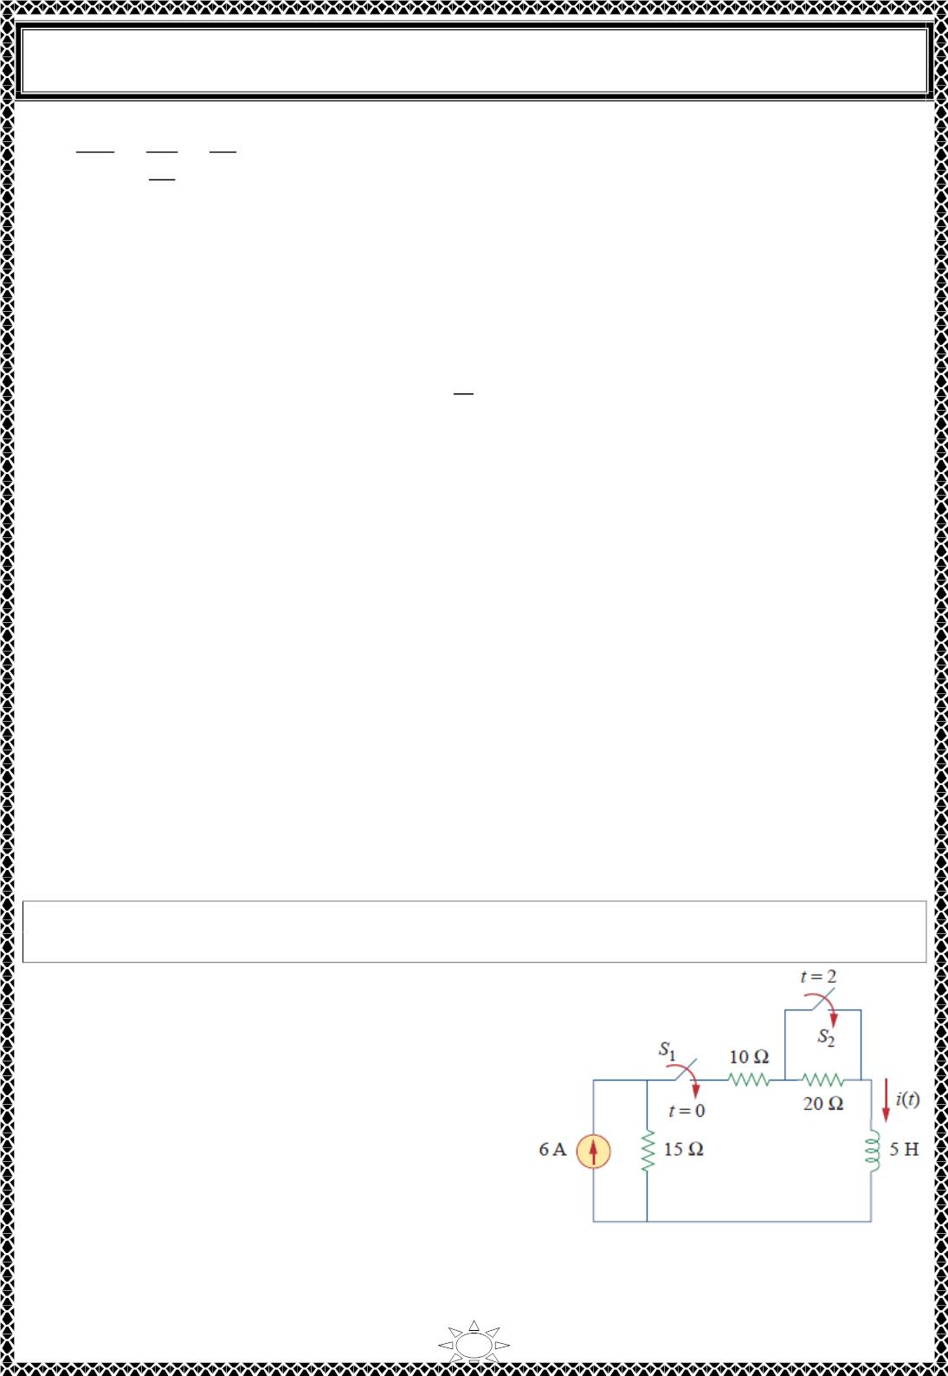
University of Diyala
Engineering College
Electrical Circuits
휏 =
퐿
5
22
3
15
22
=
=
푠
푅_{푇ℎ}
Hence,
ꢀ(푡) = ꢀ(∞) + [ꢀ(4) − ꢀ(∞)]푒^{ꢁ(ꢂꢁꢃ)/ꢄ}, 푡 ≥ 4
We need (푡 − 4) in the exponential because of the time delay. Thus,
ꢅꢆ
ꢀ(푡) = 2.727 + (4 − 2.727)푒^{ꢁ(ꢂꢁꢃ)/ꢄ}, 휏 =
ꢇꢇ
= 2.727 + 1.273푒^{ꢁꢅꢃ66ꢈ(ꢂꢁꢃ)}, 푡 ≥ 4
Putting all this together,
0,
푡 ≤ 0
0 ≤ 푡 ≤ 4
푡 ≥ 4
_{ꢀ(푡) = {4(1 − 푒}^{ꢁꢇꢂ}) ,
2.727 + 1.273푒^{ꢁꢅꢃ66ꢈ(ꢂꢁꢃ)},
Trail Version
Trail Version
Trail Version
Trail Version
Trail Version
Trail Version
Trail Version
Trail Version
Trail Version
Trail Version
Trail Version
Trail Version
Trail Version
At 푡 = 2,
ꢀ(2) = 4(1 − 푒^{ꢁꢃ}) = 3.93퐴
At 푡 = 5,
ꢀ(5) = 2.727 + 1.273푒^{ꢁꢅꢃ66ꢈ} = 3.02퐴
H.W. 13: Switch 푆 in Fig.1 is closed at 푡 = 0, and switch 푆 is closed at 푡 = 2푠.
ꢅ
ꢇ
Calculate ꢀ(푡) for all 푡. Find ꢀ(1) and ꢀ(3) .
Answer:
ퟎ,
풕 < ퟎ
ퟎ < 풕 < ퟐ
풕 > ퟐ
_{풊(풕) = {ퟐ(ퟏ − 풆}^{ꢁퟗ풕}) ,
ퟑ. ퟔ − ퟏ. ퟔ풆^{ꢁퟓ(풕ꢁퟐ)},
풊(ퟏ) = ퟏ. ퟗퟗퟗퟕ푨, 풊(ퟑ) = ퟑ. ퟓퟖퟗ푨.
Fig.1
36

Slide 10
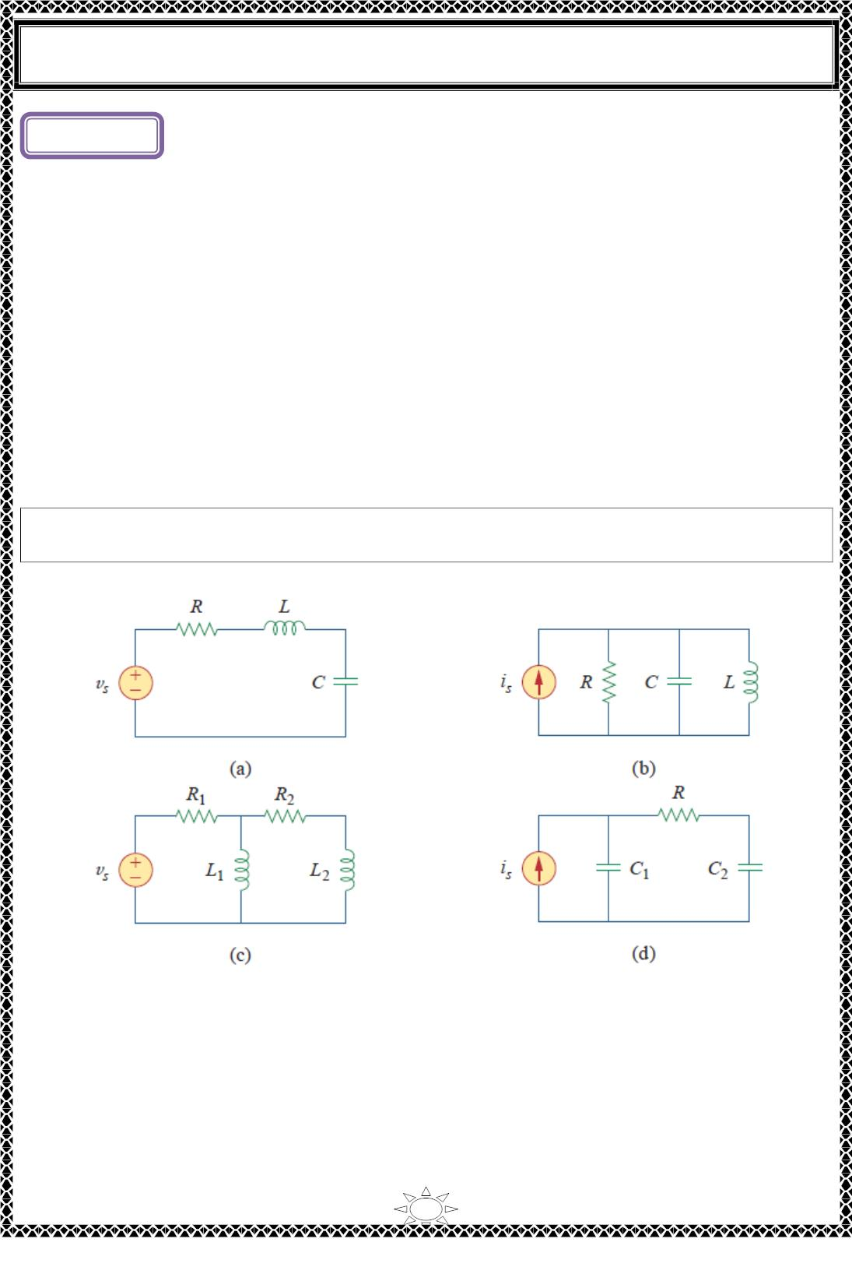
University of Diyala
Engineering College
Electrical Circuits
Lecture ( )
Transient
Second-Order Circuits
1) Introduction
In the previous lecture we considered circuits with a single storage element (a capacitor or
an inductor). Such circuits are first-order because the differential equations describing them are first-
order. In this lecture we will consider circuits containing two storage elements. These are
known as second-order circuits because their responses are described by differential equations that contain
second derivatives.
Typical examples of second-order circuits are RLC circuits, in which the three kinds of
passive elements are present. Examples of such circuits are shown in Fig. 1.1(a) and (b).
Other examples are RL and RC circuits, as shown in Fig. 1.1(c) and (d). It is apparent from
Fig. 1.1 that a second-order circuit may have two storage elements of different type or the same type
(provided elements of the same type cannot be represented by an equivalent single element).
A second-order circuit is characterized by a second-order differential equation. It
consists of resistors and the equivalent of two energy storage elements.
Trail Version
Trail Version
Trail Version
Trail Version
Trail Version
Trail Version
Trail Version
Trail Version
Trail Version
Trail Version
Trail Version
Trail Version
Trail Version
Fig. 1.1 Typical examples of second-order circuits: (a) series RLC circuit, (b) parallel RLC
circuit, (c) RL circuit, (d) RC circuit.
1

